Slide 1
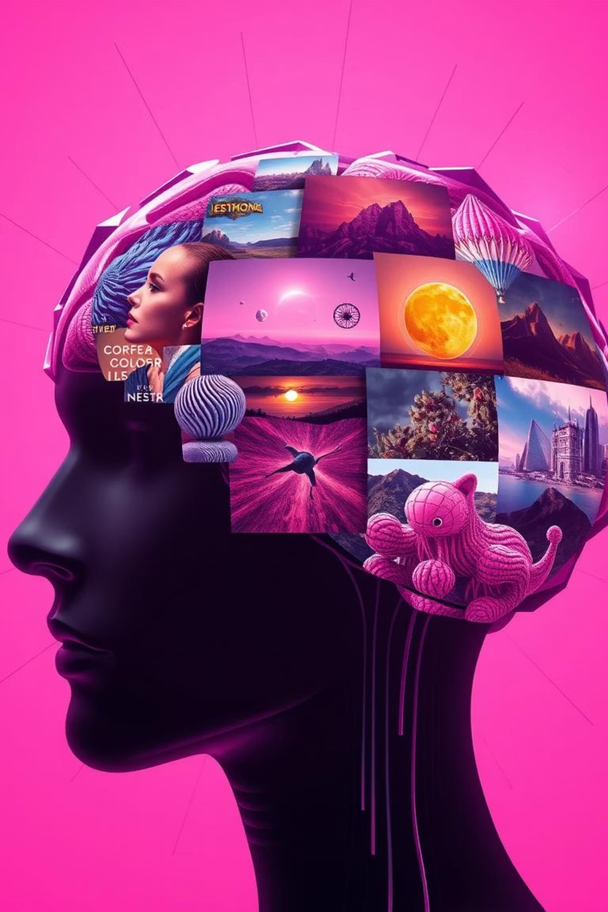
ImaGenAI
An app for AI Image Generation Model Reviews
Final Project – AI Engineering Bootcamp @ IronHack 2025
@mobenet

Slide 2
Do you know which AI image model to use?
AI image generation tools are booming, but user feedback is fragmented and informal.
Reviews are spread across platforms like Reddit, making it hard to evaluate tools objectively.
Users want to know: What’s the best tool for me?
Businesses want to understand: What do people really like or complain about?

Slide 3

Project Objectives
Collect real user reviews from Reddit
Classify them as Positive, Neutral, or Negative
Group feedback by common themes (clustering)
Use Generative AI to create short, human-style recommendation articles
Build a web app to explore the results easily

Slide 4
Common Steps I took
Collecting Data
LLM call to set the most important subreddits, search terms and AI Image Generation Models using RedditReviewScrapper class.
Selected 5 of the Models (Midjourney, DALL·E, Stable Diffusion, Runway ML, Leonardo AI) and made two calls towards reddit using again RedditReviewScrapper class to scrap Reddit.
Obtained two Datasets: the first one with 1871 reviews using more specific Search Terms and the second one with 22k reviews using more general Search Terms.
I selected the 22k Dataset with the general search terms (my experience, hands-on, comparison, tried) instead of the 1800 Dataset where the search terms were more specific (ethics, control, pricing, style) —> First error?
Cleaning Data
Selected 300 reviews per product obtaining 1500 total rows dataframe with meaningful reviews
Decided to take two separated approaches

Slide 5

First Approach
Sentiment Analysis
Applied HF Sentiment Model cardiffnlp/twitter-roberta-base-sentiment-latest however, many Reddit reviews exceeded the model's 512-token limit.
Cleaned the 22k Dataset extracting the reviews reaching the max tokens and applied Sentiment Analysis once again
Filtered the Dataset to keep 5k Reviews with a balanced Sentiment Results per Model
Modeling and Clustering
Used HF model Sentence Transformers to embed the reviews into semantic vectors followed by BERTopic to group them into 6 topics
Obtained inconsistent results due to:
Highly variable and informal language in Reddit comments
Topics overlapped and lacked coherence
Outcome: Too noisy and unreliable for final output generation.

Slide 6

Second Approach
Improved Approach: Clean, Summarize, Classify with GPT
T5 Summarization:
Applied T5 summarization to reduce noise and unify language after cleaning the text of unwanted characters
GPT-4 Classification:
Used GPT-4 to classify summarized reviews:
Sentiment: Good / Bad / Neutral
Key Points: Extracted in structured JSON
TF-IDF Vectorization:
Converted grouped (model + sentiment) key points into numerical vectors
LDA Topic Modeling:
Applied LDA to discover main discussion topics per product and sentiment
Assign each group of reviews to a dominant topic
GTP-4 Article Generation:
Prompted to write short product summaries from most dominant topics
Outcome: Much more consistent, interpretable topics and human-readable summaries per product

Slide 7
What did users really say?
Reviews were classified and grouped per product into positive and negative sentiments. For each sentiment, key discussion topics were identified using LDA. Based on these clusters, GPT-4 generated review-style articles for every model.
Example Findings:
Model
Positive Topics
Negative Topics
DALL·E
Usability, creativity
Inconsistent image quality
Midjourney
Visual aesthetics
Lack of control, prompt sensitivity
Stable Diffusion
Flexibility, open source
Complexity, artifacts

Slide 8
Interactive Web Interface
Built with Streamlit for easy access to the generated reviews
Users can:
Select a model from the dropdown
View a concise, GPT-written article summarizing real user feedback
See associated image for each model

Slide 9
Regrets & Improvements
Missed opportunity with smaller dataset
I initially discarded a highly relevant 1871-review subset with specific search terms, thinking it was too small. I now think it could have produced cleaner results.
Used full dataset too early
I applied the entire dataset across all steps instead of working in smaller, testable batches. This made iterations slower and riskier.
Lack of fine-tuning
I would have loved to fine-tune the summarization model (T5) to adapt it more closely to the informal, Reddit-style language and make the first approach work
Wanted to make the first approach work
The Sentiment CardiffNLP model and the BERTopic-based pipeline had potential. With better embeddings and noise reduction, it might have yielded useful clusters.
Results Evaluation and Visualization

Slide 10

Let's see the app !
Thank you for your attention
<3

